Slide 1

NeuroDiversity
Grad Hack 2019
c
Team 9
Saurabh Singh
Saurabh Singh

Slide 2
“IMAGE ANALYTICS USING CONVOLUTIONAL NEURAL NETWORK”
TOPIC

Slide 3
1
2
3
PROBLEM STATEMENT
APPROACH & PROPOSED SOLUTION
PROTOTYPE
In the box!

Slide 4
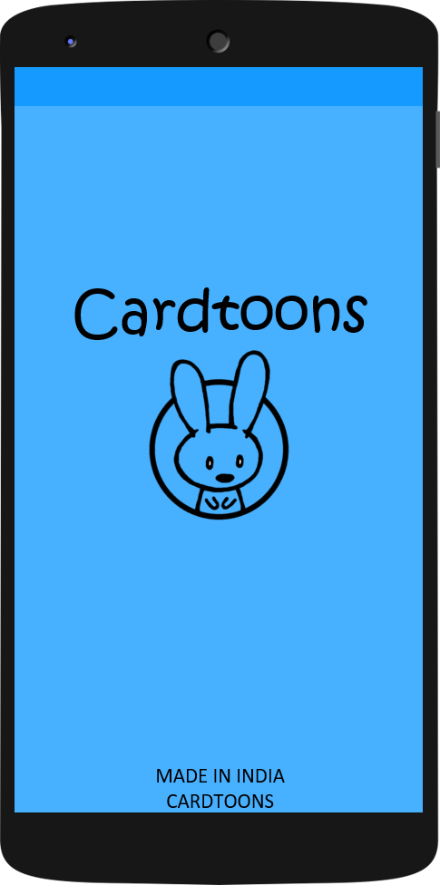

Problem Statement
According to a study*, curiosity levels in children is at a maximum in the age bracket of 5 – 10 years. Kids tend to ask questions about things that they have not seen before.
But many times their curiosity is left unquenched due to various reasons.
There is a need of a system that can help kids to identify unknown objects even in the absence of adults.
*Conducted by Department of Psychology, Carnegie Mellon University

Slide 5



Problems In a Nutshell.
Absence of adults
Adult’s lack of knowledge
Occasional unwillingness of adults

Slide 6

Proposed System
Solution

Slide 7
Solution
A mobile application which helps kids to recognize unfamiliar objects by the click of an image. It will use mobile frontend and Convolutional Neural Network (CNN) at the backend to recognize the images.

Slide 8
Usability
Now a days kids are very familiar and comfortable with devices like smartphones and tablets.
Sometimes kids as young as 4yrs old can be found playing games like Candy Crush and Temple run.
Also, after the inception of Jio in India, 4G has become a norm and can be easily found in any smartphone at all the times.

Slide 9
Scope
This app has a potential to cater the following audience :
Children
Farmers
Botanists

Slide 10

Approach
Our Way!

Slide 11
Approach
We propose to implement a three tier approach in our project:
MOBILE FRONTEND: We will make applications on all the leading mobile platform. Application will be used to take the photo and also to display the output generated by the backend.
PHP AND PYTHON: PHP to receive/send requests by/to the app and python to run the shell commands and send the query to CNN model.
NEURAL NETWORK: CNN model will be used to recognize the query image.

Slide 12
Prototype
Our Way!

Slide 13
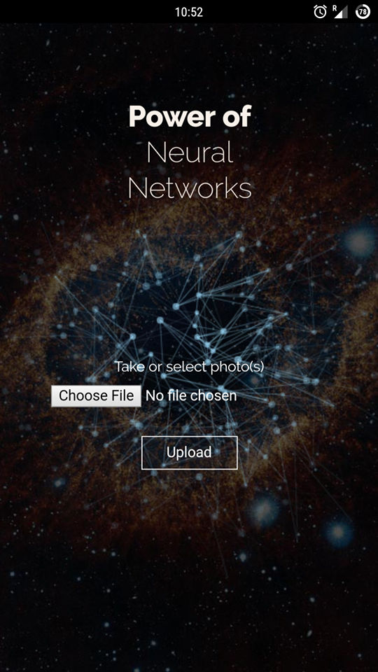
Prototype
Our prototype is compatible with all
the leading mobile platforms
No APIs
have been used during the process
of making of this prototype.
Actual screenshot of the prototype

Slide 14
Mobile Application
The android frontend application have been made using the Apache Cordova mobile development framework.
The application gives the user two
ways to submit the image:
Using camera input.
Directly from gallery.

Slide 15
PHP and Python
The image send by the application will be received by the server which will run a PHP script. The PHP script will then rename the file. This renamed file will send to the python code which will resize the image. This resized image is then fed to the neural network.

Slide 16
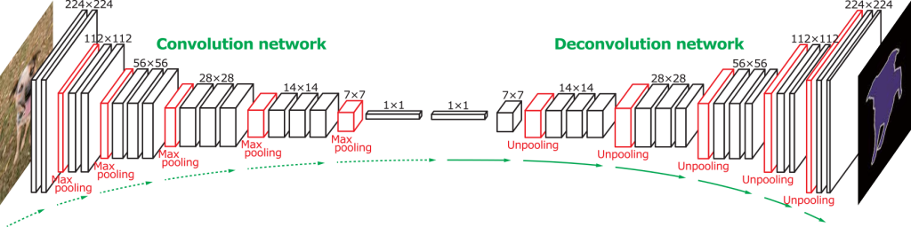
Neural Network
Our network:
Can classify four day to day things: Roses, Sunflowers, Apples and Bananas
Contains 6 level Convolutional Neural Network.
We have made three backend models having accuracy 65%, 67% and 70% respectively.
The model we have used is the one with accuracy of approx. 70%.

Slide 17
Using this application an essence of Digital Learning is brought in the palm of the children (or anyone who uses it).

Slide 18
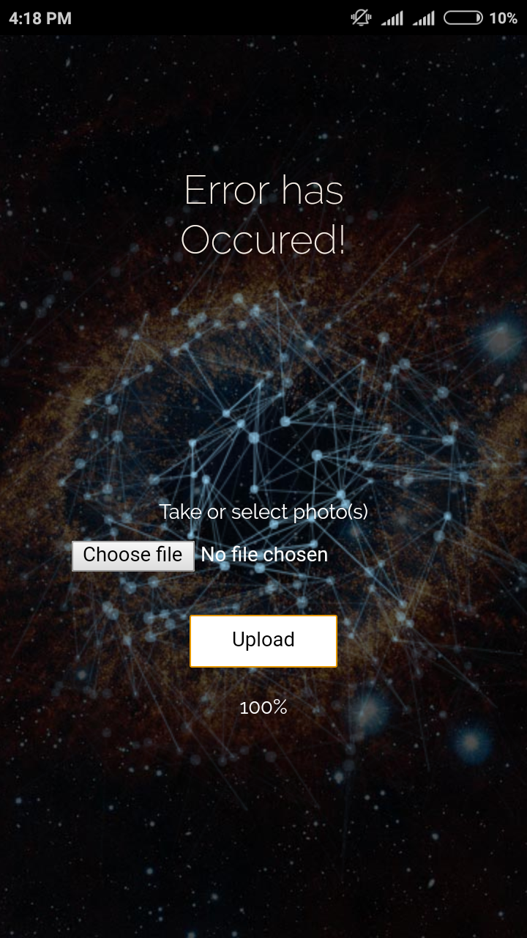

Slide 19
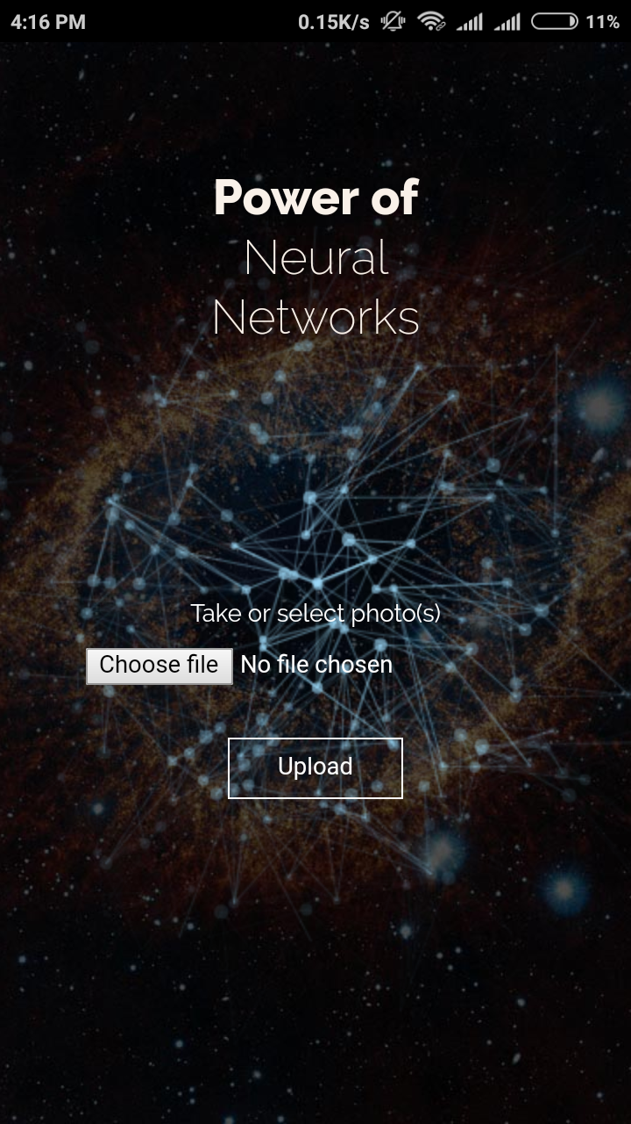

Slide 20
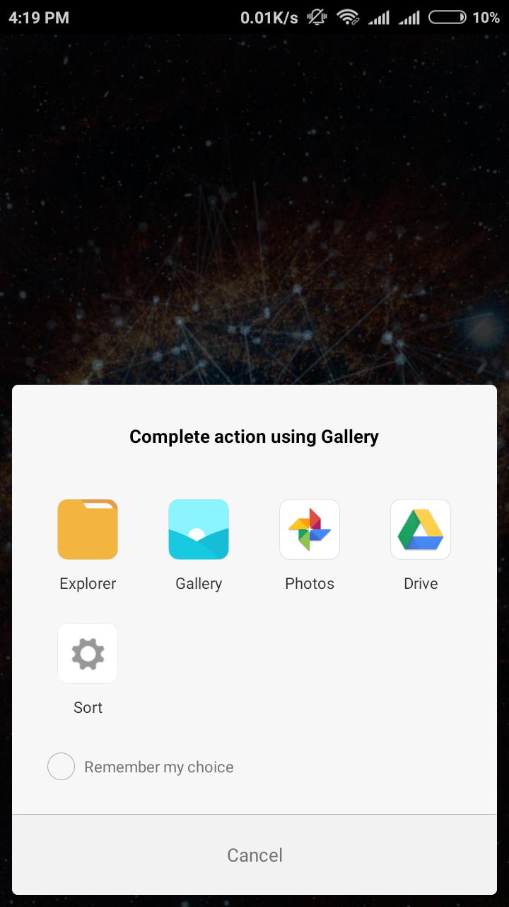

Slide 21
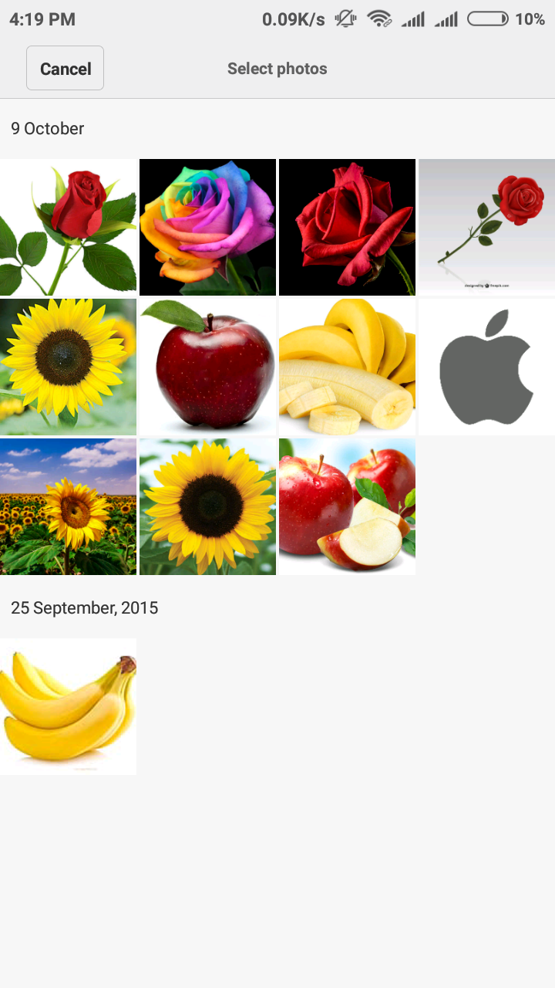

Slide 22
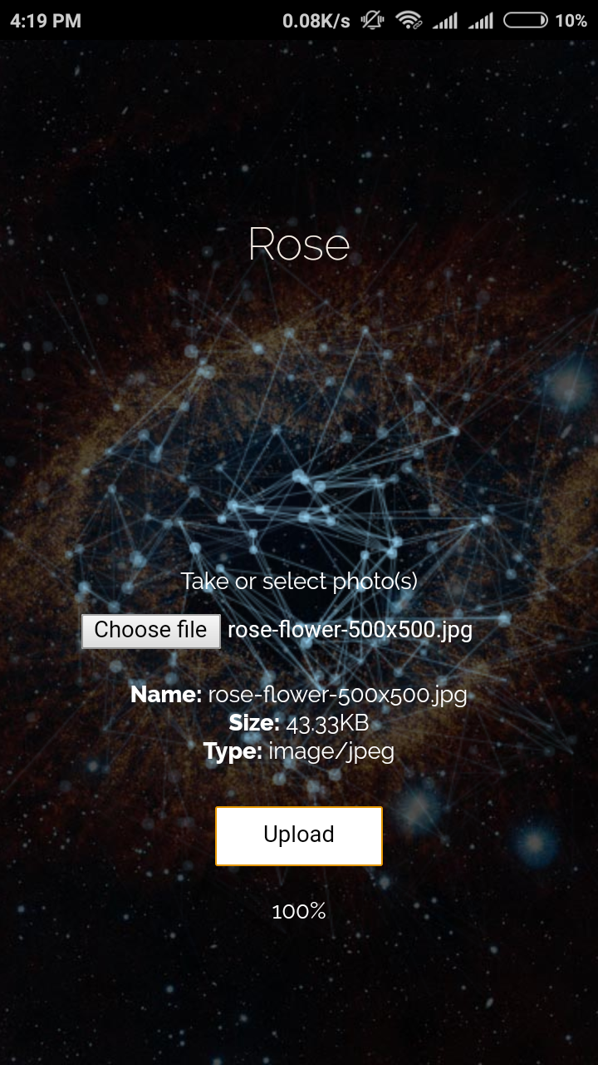

Slide 23
“Curiosity is the wick in the candle of learning”
- William Arthur Ward
Thank you :)
questions ?

Slide 24

3
Thank you :)
questions ?
Benefits Of the System
In the box!

